Slide 1

Module 1
Regression Basics
Notes:
Guidelines
Use section headers to chunk content in your presentation.
Use the same style of section header throughout your presentation.
Keep your title to no more than 2 lines.

Slide 2
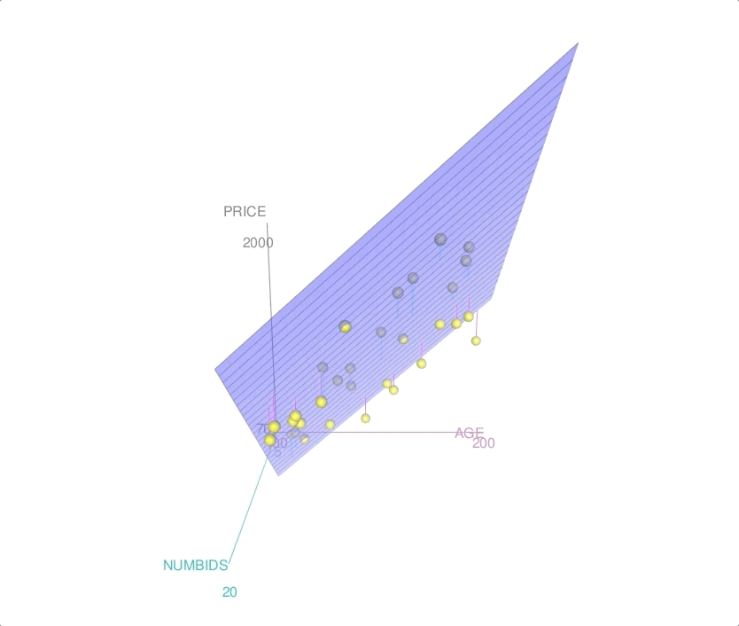
General Form of MLR
Notes:
Guidelines
Use a title slide at the beginning of your presentation. There are 9 variations of title slides to choose from.
If you will have a series of slideshows, we recommend using the same style of title slide for each presentation.
Keep your title to no more than 2 lines.
Do not change the font style or font size of the title or subtitle.

Slide 3
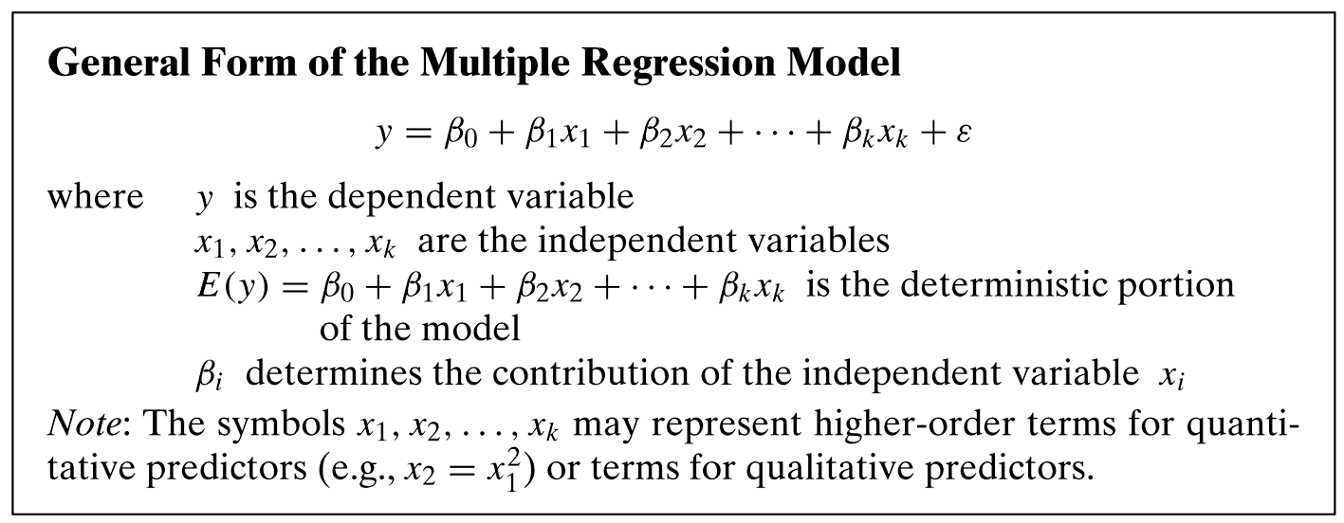
Population Model

Slide 4
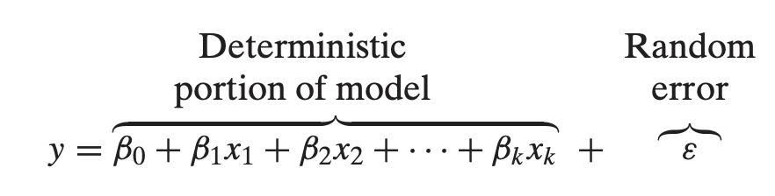
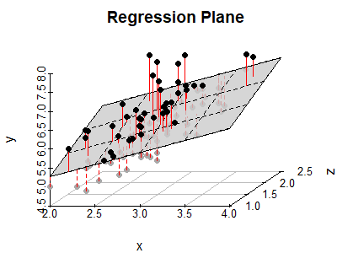
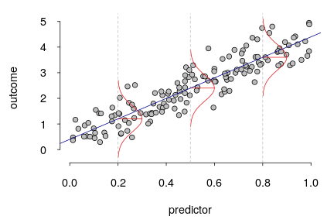
Population Model
1 predictor
2 predictors
y
y
x₂
x
x₁

Slide 5
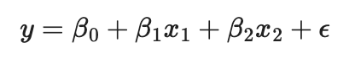
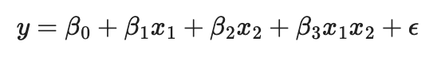
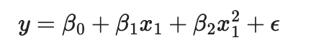
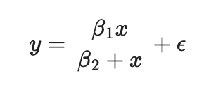
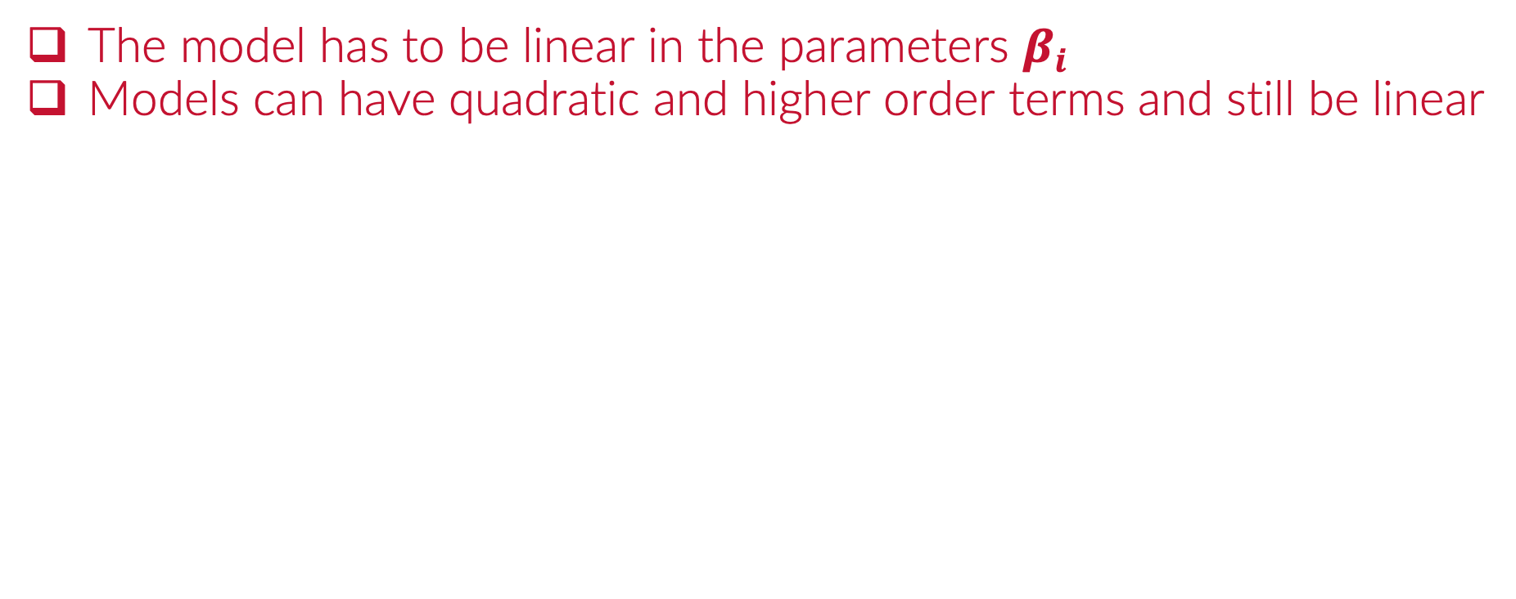
Linearity
The model has to be linear in the parameters $β_{i}$
Models can have quadratic and higher order terms and still be linear
LINEAR IN THE PARAMETERS
✓
✓
✓
PARAMETERS
✘

Slide 6
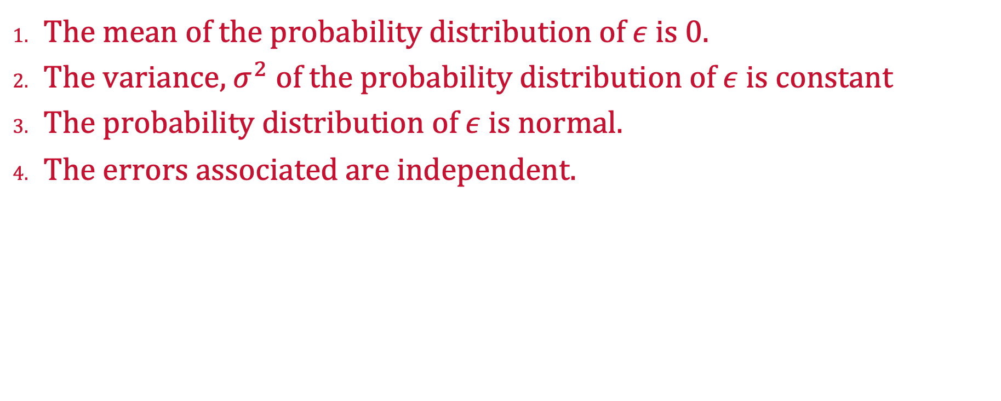
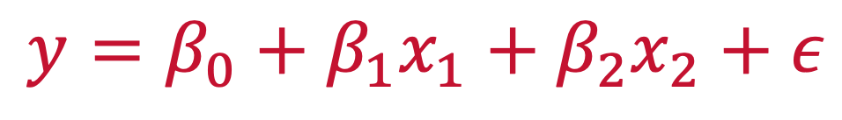
Assumptions for Inference in MLR
The mean of the probability distribution of $ε$ is 0.
The variance, $σ^{2}$ of the probability distribution of $ε$ is constant
The probability distribution of $ε$ is normal.
The errors associated are independent.
$$y=β_{0}+β_{1}x_{1}+β_{2}x_{2}+ε$$

Slide 7
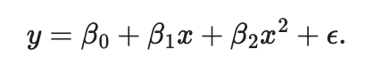
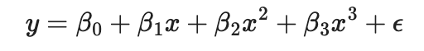
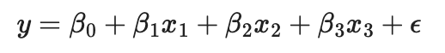
Order of Model
Highest Exponent of any Predictor Variable
A Model With no Higher-Order Terms is a First-Order Model
Higher-Order Terms
2nd order model
3rd order model
1st order model
$$y=β_{0}+β_{1}x_{1}+β_{2}x_{2}+β_{3}x_{1}x_{2}+β_{4}x_{1}^{2}+β_{5}x_{2}^{2}+ε$$

Slide 8
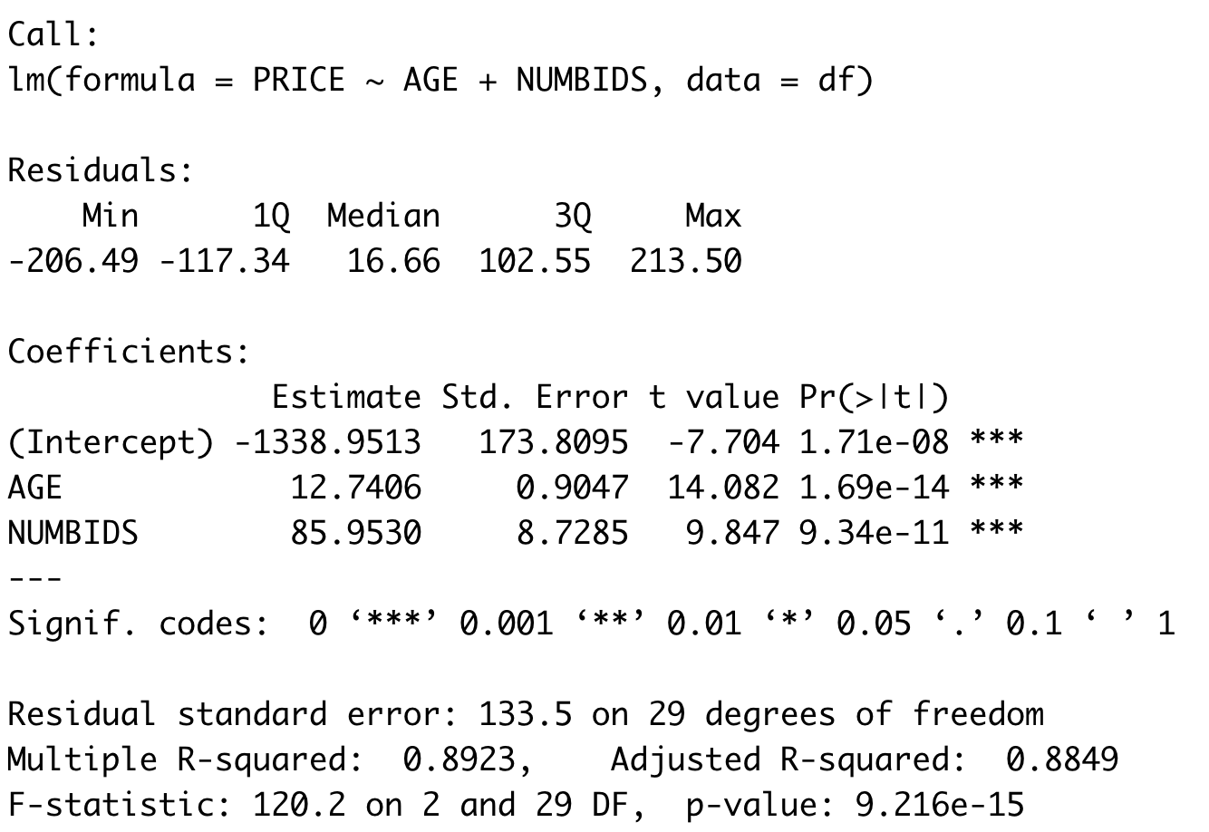
Inference and Estimation
Assumptions need to hold for p-values to make sense

Slide 9
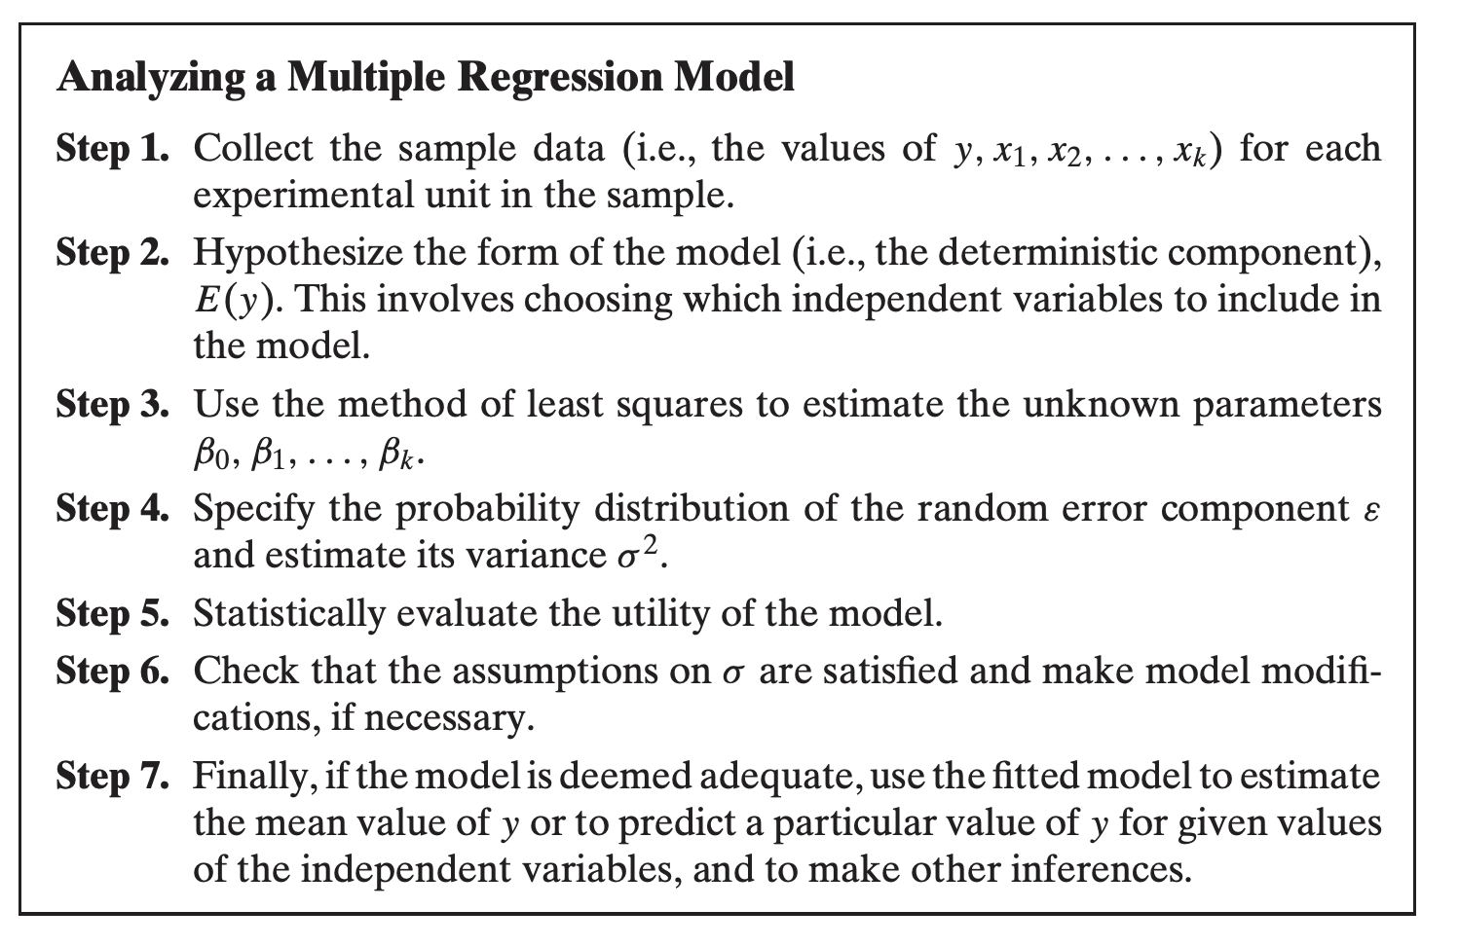
Steps to Fit LS Regression

Slide 10

Practice

Slide 11
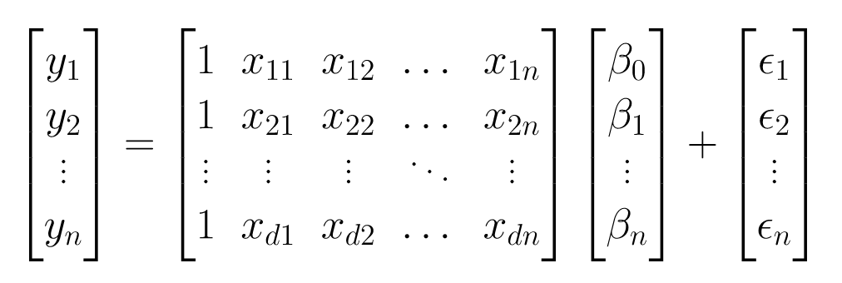
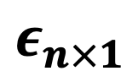
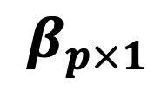
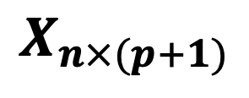
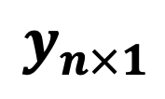
Matrix Formulation on MLR
The formulation does not change
$$y_{n×1}$$
$$X_{n×(p+1)}$$
$$β_{p×1}$$
$$ε_{n×1}$$

Slide 12
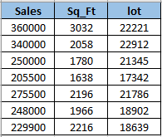

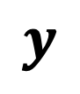
Example
Extracting the X Matrix (Design Matrix) and y vector
$$y$$
$$X$$

Slide 13
The X Matrix (Design Matrix)
In LR a column of 1s is added to the X Matrix to estimate the y-intercept
DESIGN MATRIX
Independent
(with no singularities)

Slide 14
The X Matrix (Design Matrix)
In LR a column of 1s is added to the X Matrix to estimate the y-intercept
intercept
1
1
1
1
1
1
1
Independent
(with no singularities)

Slide 15

The $y$ vector
The observations of the response variable

Slide 16
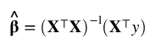
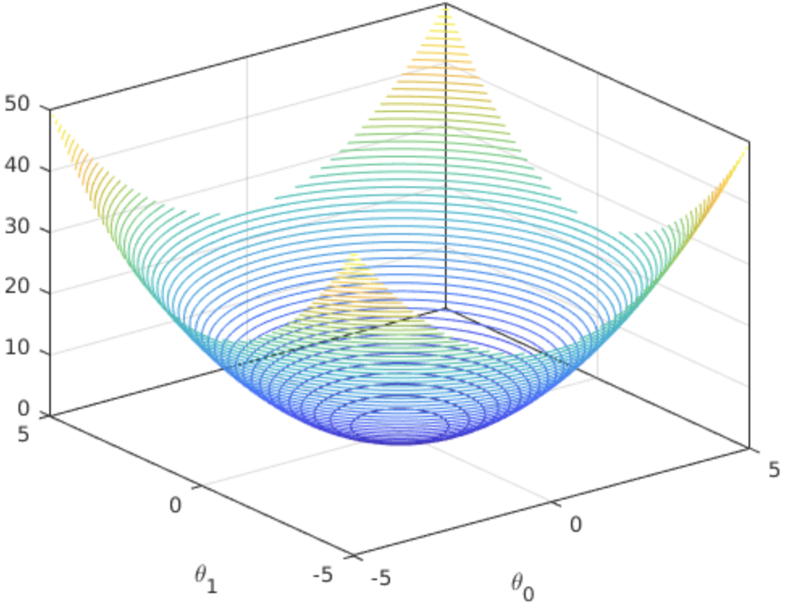
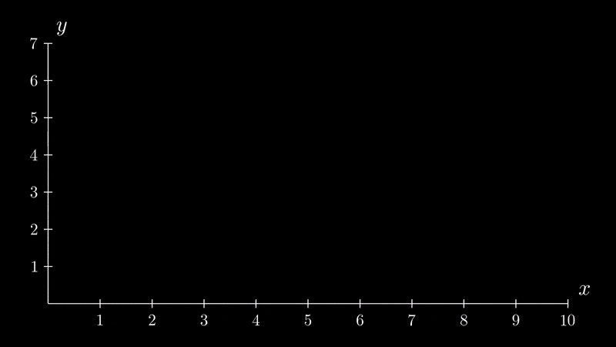


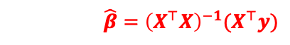
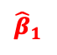
The Method of Least Squares
The least-squares estimates are obtained by selecting the estimates that minimize SSE.
$$SSE$$
$$\hat{β}={\left(X^{⊤}X\right)}^{−1}(X^{⊤}y)$$
$${\hat{β}}_{0}$$
$${\hat{β}}_{1}$$

Slide 17
Practice

Slide 18
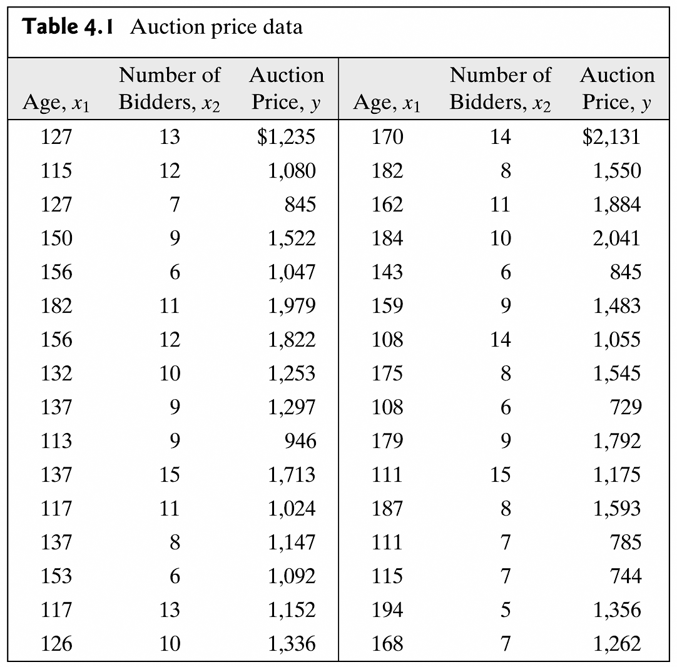
Auction Price Data Example
Let’s predict the auction price using age and number of bidders

Slide 19
Practice

Slide 20
Regression Fit
b₀
b₁
b₂

Slide 21
y-intercept Interpretation
This is the estimate of the price of the clocks with AGE zero and Zero bidders

Slide 22
Slopes Interpretation
AGE: As AGE increases by 1 year, the we estimate the price of the Clock to increase $12.74 considering the same number of bidders

Slide 23
Slopes Interpretation
NUMBIDS: As NUMBER OF BIDDERS increases by 1, the we estimate the price of the Clock to increase $85.95 considering clocks of the same AGE (holding AGE constant)
PARTIAL SLOPE COEFFICIENTS

Slide 24
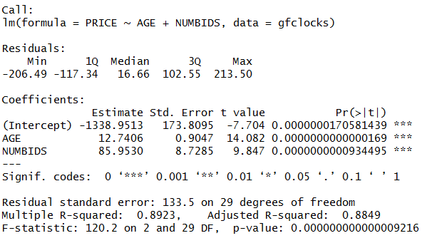
RMSE Interpretation
RMSE is an estimate of the error in the
prediction

Slide 25
RMSE Interpretation
We estimate the predictions of the model
To be off by about $133.5

Slide 26
Error Degrees of Freedom
n – (k + 1)
32 – (2 + 1)
Error Degrees of Freedom

Slide 27
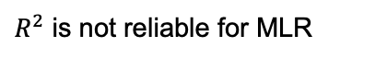
R-Squared
$R^{2}$ is not reliable for MLR

Slide 28
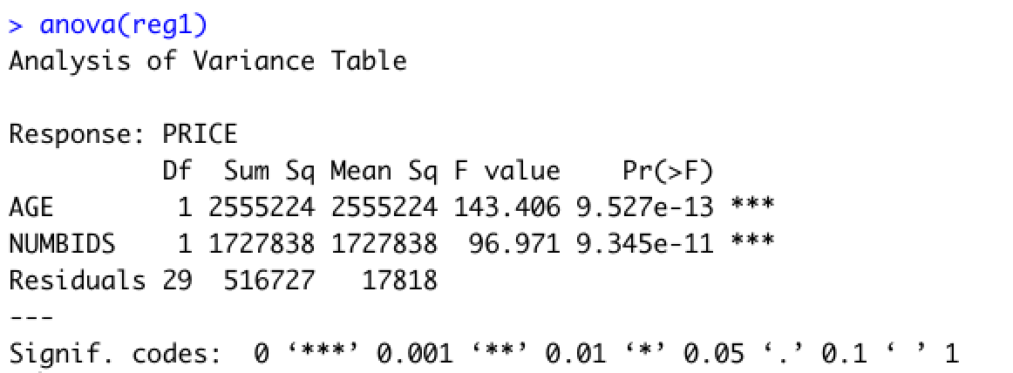
ANOVA Table
SSR (AGE) - Explained Variation contributed by AGE
MSE (AVG. UNEXPLAINED VARIATION)
SSR (NUMBIDS | AGE) - Explained Variation contributed by NUMBIDS
Given AGE is in the model
SSE (UNEXPLAINED VARIATION)
TOTAL SSR = SSR (AGE) + SSR (NUMBIDS | AGE)

Slide 29
Regression Plane

